Slide 1
TOKO KUE ANY CAKE
Whindy Ovianty 1910803001
Nurul Hima Hidayati 1910803002
Putri Nurizki 1920803023
Rosalina Dewi Yolanda 1920803030

Slide 2
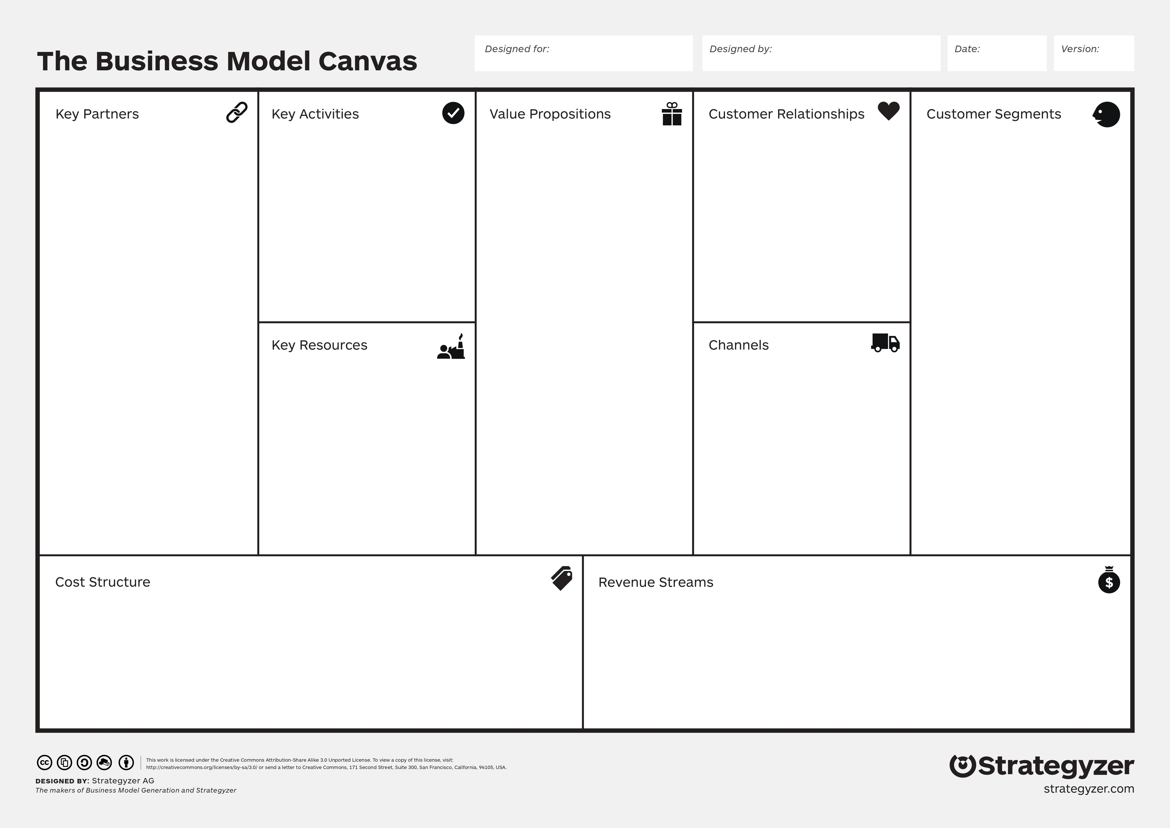
CONTENTS OF THIS TEMPLATE
Pelayanan pesan antar melalui web dan Ojek Online
Promo pembelian
Cabang toko
Preorder kue ulang tahun
Promo
Kualitas Produk
Free Cake Custom
Here’s what you’ll find in this Slidesgo template:
A slide structure based on a multi-purpose presentation, which you can easily adapt to your needs. For more info on how to edit the template, please visit Slidesgo School or read our FAQs.
An assortment of illustrations that are suitable for use in the presentation can be found in the alternative resources slide.
A thanks slide, which you must keep so that proper credits for our design are given.
A resources slide, where you’ll find links to all the elements used in the template.
Instructions for use.
Final slides with:
The fonts and colors used in the template.
A selection of illustrations. You can also customize and animate them as you wish with the online editor. Visit Stories by Freepik to find more.
More infographic resources, whose size and color can be edited.
Sets of customizable icons of the following themes: general, business, avatar, creative process, education, help & support, medical, nature, performing arts, SEO & marketing, and teamwork.
You can delete this slide when you’re done editing the presentation.
Menyediakan pesan antar
Promo belanja
Cabang toko di daerah tertentu
Preorder kue ulang tahun
UMKM
Sekolah
Masyarakat Umum
Ojek Online
Kantin sekolah
Marketing
Produksi
Kasir
Administrasi
Cabang toko
kurir
Sosial Media
Internet
Iklan Konvensional
Gaji Karyawan
Biaya Operasional
Hasil Penjualan Produk
Paket Event

